Slide 1
2012-05-08

Slide 2
Hades
Keeper and Purifier of crappy data

Slide 3

Agenda
Where
What, Why and How???
InputService
JobsRunner
AdminUI

Slide 4
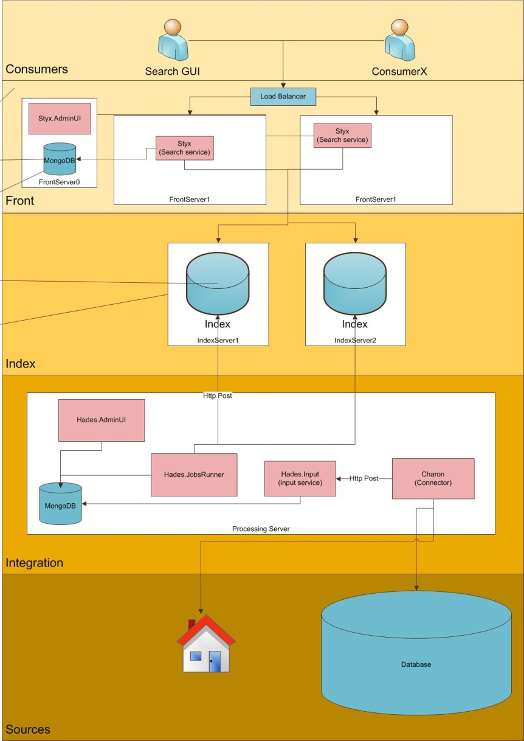
Where
Just like the mythological realm it resides in its own sphere: the Processing server
Three components:
InputService
think ReceiveService, IndexService ..
JobsRunner
think Hydra, Open Pipeline
AdminUI
Think awesome

Slide 5

Why - InputService
”We need to be able to reindex data without going back to the data sources”

Slide 6
What - InputService
Receives documents
Persists them
A document is simply a list of string key value pairs and an ID
All received documents belongs to an explicitly set source
Eg. ”customer”, ”insurance”, ”mail”
4.0 .NET application
WCF service hosted as a windows service
Exposing endpoints over Http, Tcp, Udp...

Slide 7
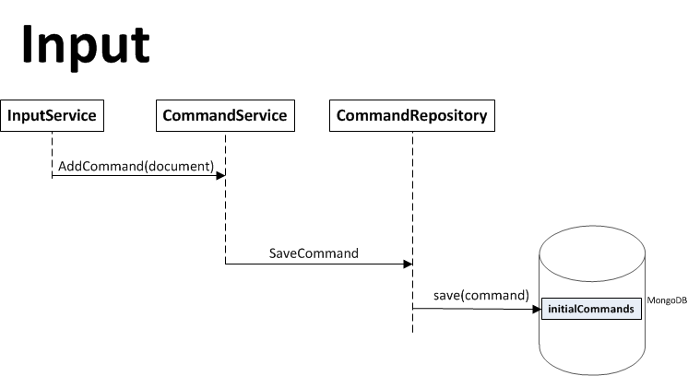
How - InputService
Data is coming in as Document objects
Serialized to a database
So far either MongoDB or RavenDB
Done – finito! Nothing more will happen here
Scales with servers

Slide 8

Why - JobsRunner
”We need to clean this crappy data”
”I want to add more data to this document!”
”The search domain should have a semi-structured (controlled) scheme – all data should be ’normalized’”

Slide 9
What - JobsRunner
Running scheduled jobs
Central jobs include:
Processing a document
Using scripts for transformation
Changes effective immidiatly
No hardcore programming knowledge needed
Dispatching a processed document
4.0 .NET application
WCF service hosted as a windows service
Exposing endpoints over Http, Tcp, Udp...

Slide 10
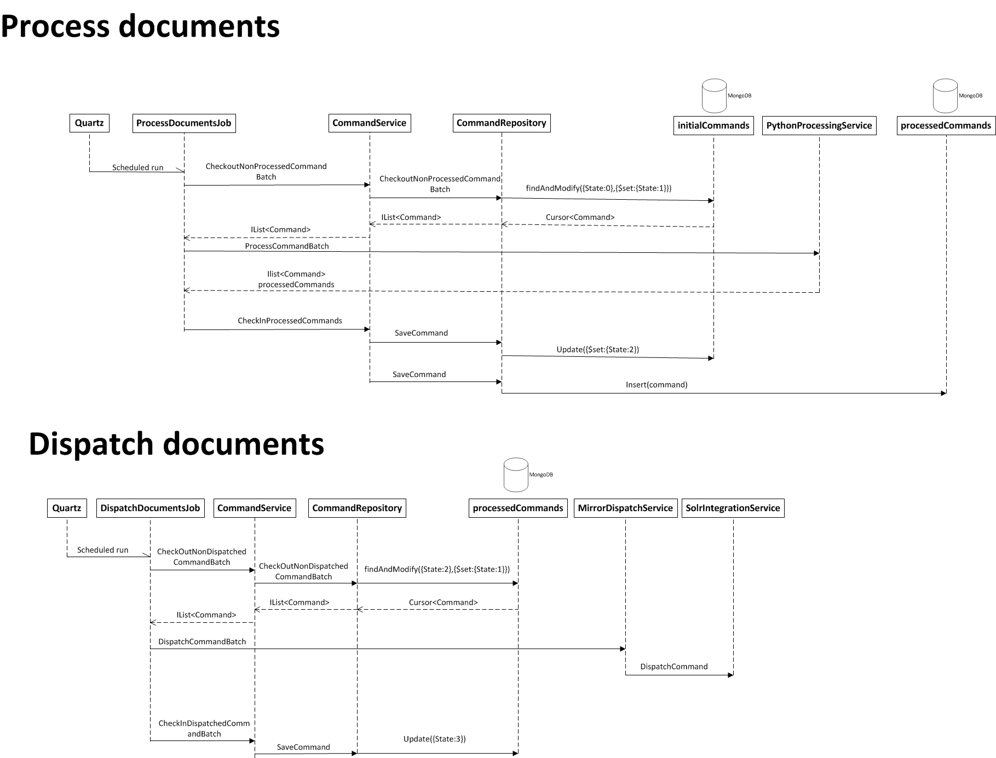
How - JobsRunner
Running scheduled jobs
Central jobs include:
Processing a document
Using scripts for transformation
Dispatching a processed document
4.0 .NET application
WCF service hosted as a windows service
Exposing endpoints over Http, Tcp, Udp...

Slide 11
How - JobsRunner
Using python scripts to define how a document should be transformedthe
Creating a processed document
Which fields should directly be moved over?
Which fields should be edited?
What fields should be added with what data?
Using IronPython
All .NET libraries are at our disposal!
Each source has its own script
Processed documents will be sent to the index
Scales with servers

Slide 12

Why - AdminUI
”I want to controll it all!”
”Pics or its not happening!”

Slide 13
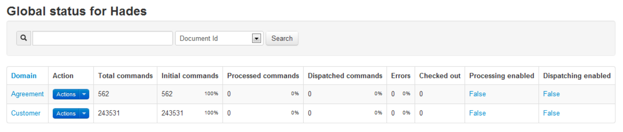
What - AdminUI
Overview of all domains
Detailed information about all documents
Fields
State (Initial, Processed, Dispatched, Error..)
.NET 4.0 ASP.MVC 3 hosted in the IIS

Slide 14

Discussion
So.. emm.. Is it like Hydra?
Think IndexService + Hydra

Slide 15
Styx
Granting the power of knowledge

Slide 16

Agenda
Where
What
Why
How
Api
Integration
Logging

Slide 17
Where
Where the action is – in the front
Preferably load balanced
All services using the same persistence store

Slide 18

Why - Styx
”We need a common service exposing an interface for requesting indexed data”
”The service needs to be platform agnostic”
”All usage must be logged in a common manner”

Slide 19
What – Styx
Web service exposing a rich interface
Consumers design their own queries
Each consumer needs an ApiKey
Defines the information context
What facets are available
How logging is handled
Logging is persisted in either MongoDB or RavenDB
Integration so far only to Solr (and IDOL)
4.0 .NET application
WCF service hosted as a windows service
Exposing endpoints over Http, Tcp, Udp...

Slide 20
What – Request/Response
All requests are done by sending a SearchRequest
All responses are wrapped inside a SearchResponse
SearchRequest
Contains an array of Searchers
The searchers are atomary – independent
A Searcher object defines an action
”FreeTextSearcher”
”FacetSearcher”
”QueryCompletion”
SearchResponse
Each Searcher has a corresponding SearcherResult

Slide 21
What – Search domain
Styx should know the structure of the search domain
The consumers should not!
Field names in the search domain are hidden
Information contexts
A set of data
”Customer”, ”Mail conversations”, ”Forum” etc.
A defined set of facets
Fields that can be faceted on
Consumers
Identified by a ApiKey
Authorized to use defined set of Information contexts

Slide 22
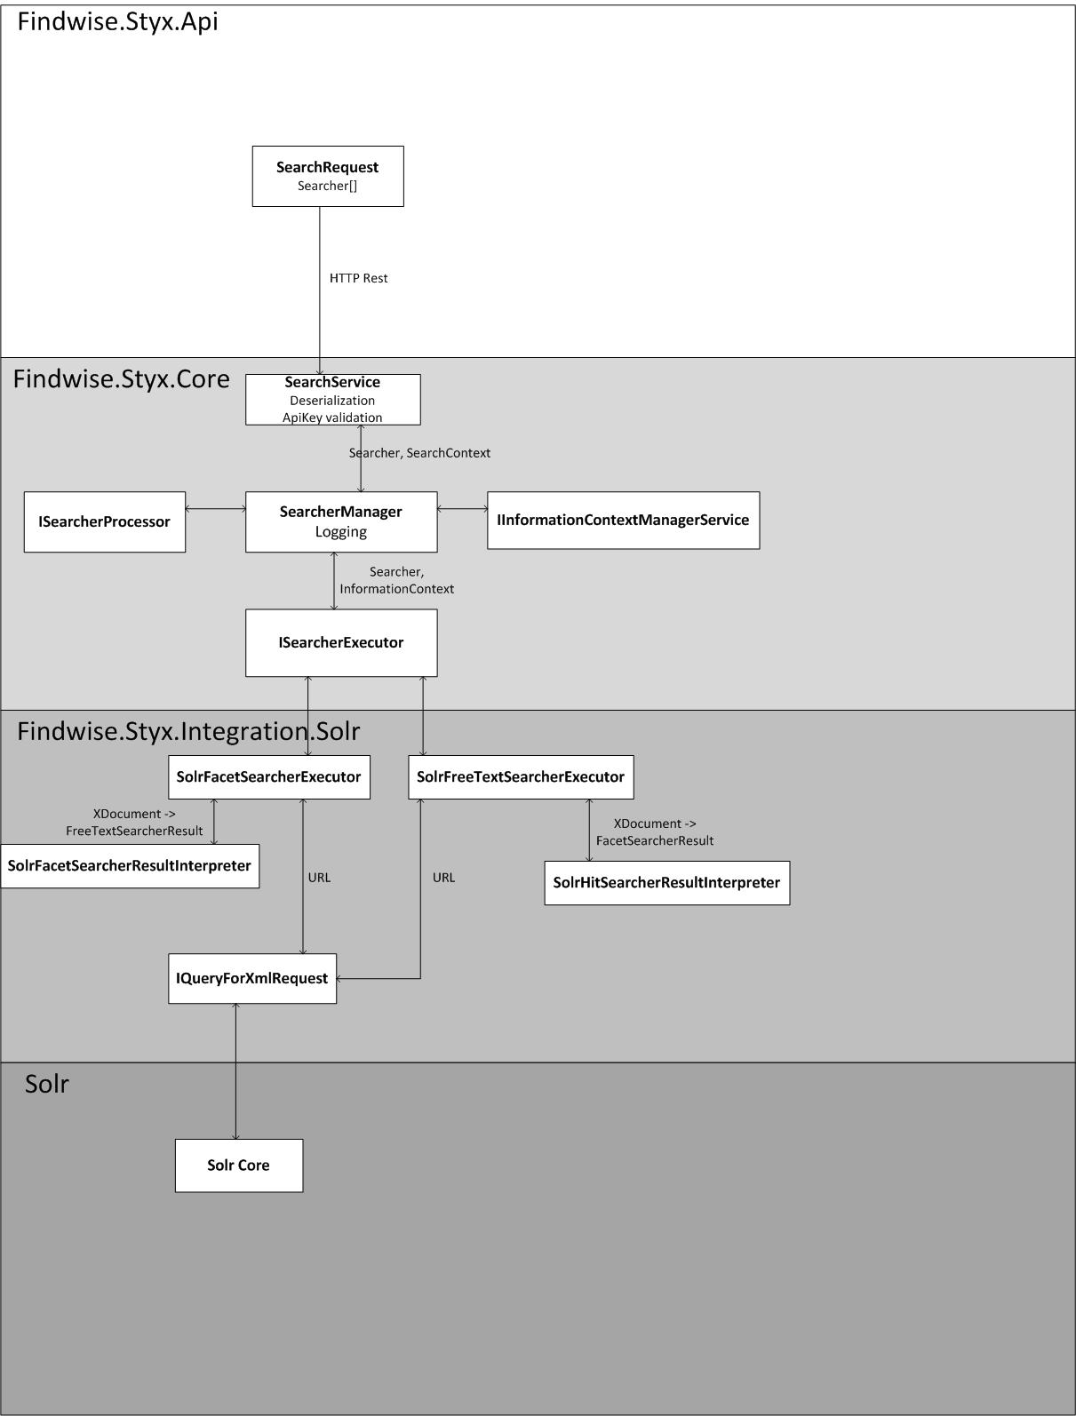
How – Detailed
The classic architectural tiers:
Api
Core
Persistence
Platform implementation
Handling all searchers defined in the Api

Slide 23


Discussion
So it’s a Jellyfish clone?
Can there only be one?

Slide 24
Magnus Månsson
2012-09-07

